Slide 1

Report :
be formed and form
Month : August (9th to 27th August 2021)

Slide 2


August (9th to 27th August 2021)
BFF | Co-ordinator's list
BFF
Sol.Jannet Lawrence
Sol.Sudha Kamlesh
Duration - 17 DAYS
Sol.Kamlesh Sudha
Sol.Sangeeta Rai

Slide 3

BFF | Teacher's list
Sol.Sibi
Mother Leema Rose
Sol.Sr.Angelica
Sol.Lissy
Sol.Theresa Cabral
Sol.Jannet
Sol.Veena
Sol.Sibi p.M
Sol.Luiza
Sol.Charan
Sol.Mini
Sol.Shebe lalu
Sol.Ajay pal
Sol. Jasmin

Slide 4
BFF | Participant's list Interested In
Teaching/Organising And Co-ordinating/Smps
Sol.Ashok Dass
Sol.Sanjay
Sol.Kamlesh Sudha
Sol.Saraswati Dass
Sol.Sudha Kamlesh
Sol.Sarita
Sol.Sangeeta Rai
8. Sol.Shushila
9. Sol.Maya Sarkar
10. Sol.Suman (Azam)
11. Sol.Anchal
12. Sol.Suman(noida)
13. Sol. Rechal
14. Sol.Kamlesh
15. Sol.Geeta

Slide 5
BFF | Summary
By The Grace Of God And With The Presence Of The Holy Spirit, Online BFF Training Was Conducted In U.P East And Was Successfully Completed With 57 Students
57
48
09
Total Students
Online
Conference

Slide 6

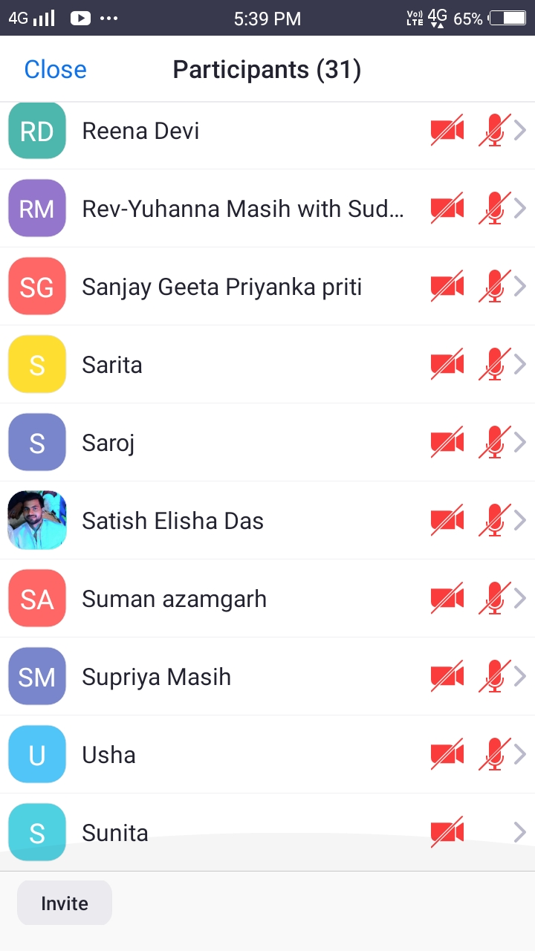
Participants: 31+20 in other mobile

Slide 7
BFF | Testimonies
1
2
3
Ten new people accepted Lord Jesus as their saviour and now want to take baptism. Amen
Name - Saraswati Dass
She was unable to live without an inhaler pump, but now she is delivered from her breathing problem as well as from arthritis. Amen.
Name - Dherinder
He had an encounter with God and later he himself proclaimed that, "I want accept the Lord as my saviour." Amen.
4
5
6
Name - Sangeeta Rai
During anointing she was anointed with oil ,and an angel came and put a new white robe
Name - Ashok Dass
During the anointing session, he felt the anointing to such an extent that he started crying and was not able to stop crying.
Name – Manoj
He got delivered from an evil spirit and accepted the Lord Jesus as his saviour.

Slide 8

BFF | Testimonies
7
8
Name - Maya Sarkar
At the time of anointing, she was experiencing the vision of crucifixion of Christ and she started crying and she felt pain in her body.
Four children received the holy spirit during anointing.

Slide 9
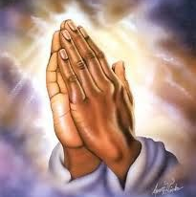
Special Thanks to
Mother Leema Rose
Sol.Angelica
Sol.Luiza
Sol.Sibi
Sol.Mini
Sol.Jasmine
Thank you so much for your support and help!
Glory to jesus.

Slide 10
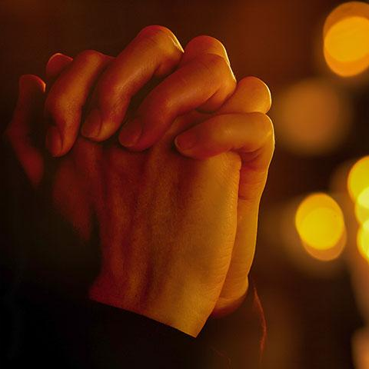
Special Thanks
First and foremost, we are very thankful to God for His protection, encouragement and guidance in every situation.
We are thankful to the entire AOJ north team and the coordinators of the west for arranging the teachers for us.
We are also thankful to all our soldiers who helped us in the chain prayer.
And we are thankful to all our participants.

